Slide 1
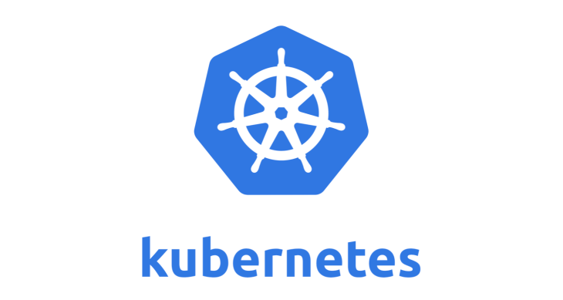
Introduction to Kubernetes​
Presenter – Vinoth Seenu/ Sr.infra developer​
Certified Kubernetes Administrator

Slide 2
Session Objective​
K8s Volumes
Persistent Volumes
PersistentVolumeClaims
Configmaps
Secrets

Slide 3
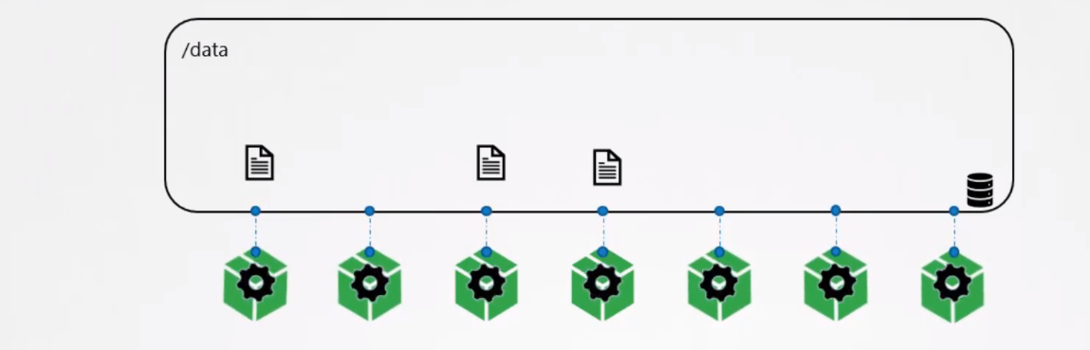
Volumes
Why we Need a Volume ?
Volumes generally use to store any number of Data’s based on there
Capacity. Likewise In k8s Volumes are used to store a logs,details,data’s
Pod communication, deployment details, pod details, ect to store and
Retrive to avoid data lose and security prevention(backup).

Slide 4
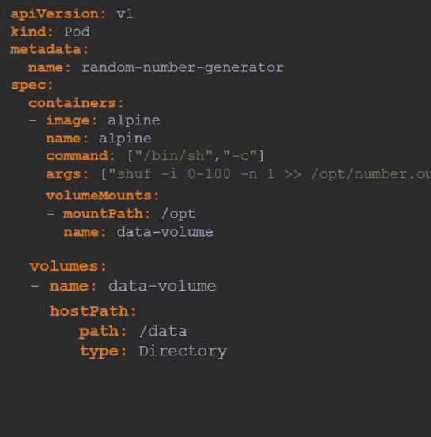
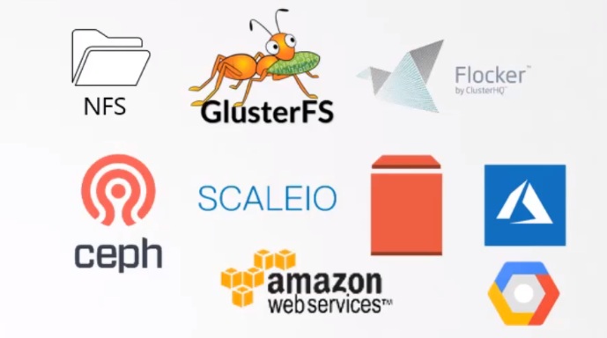
volumes

Slide 5
Persistent volume(PV)
It is a resource in the cluster just like a node is a cluster resource. PVs are volume plugins like Volumes, but have a lifecycle independent of any individual Pod that uses the PV
Users can pull the amount of storage from persistent volume to store & re-store the data’s and logs.
https://kubernetes.io/docs/concepts/storage/persistent-volumes/

Slide 6
The access modes are
ReadWriteOnce -- the volume can be mounted as read-write by a single node
ReadOnlyMany -- the volume can be mounted read-only by many nodes
ReadWriteMany -- the volume can be mounted as read-write by many nodes

Slide 7
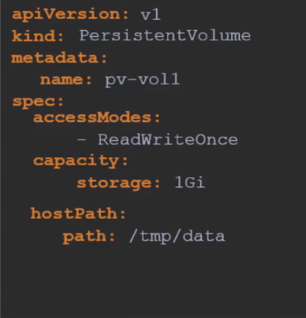
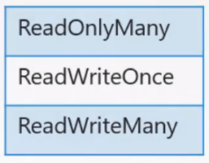
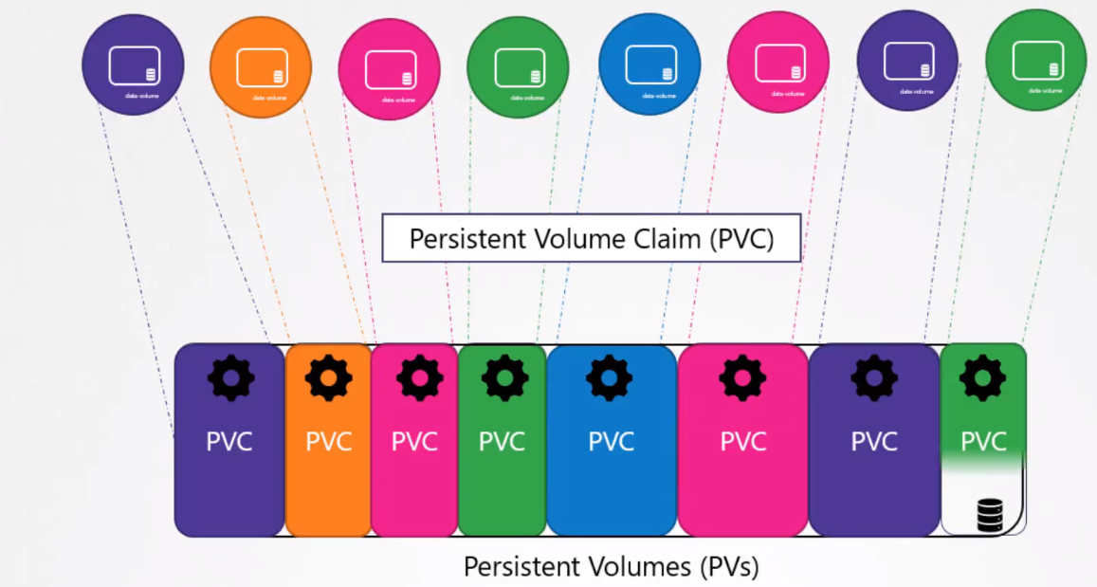
Persistent volume

Slide 8
PersistentVolume
Kubectl get pv <pv-name>
Kubectl describe pv <pv-name>
Kubectl delete pv <pv-name>

Slide 9
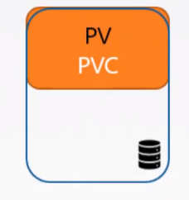
PersistentVolumeClaims (PVC)
Every persistent-volume claim can bounded to a persistent volume to occupies the memory.
User has mention the required memory unity that needs to claim from actual PV.
Claimed / bounded PVC has to attach with minos or resource to use the memory
K8s find the Sufficient capacity pv to claim pvc
Labels and selectors used to bind the pv with pvc.
Claimed volume 1 Gi
Total volume 5 Gi

Slide 10
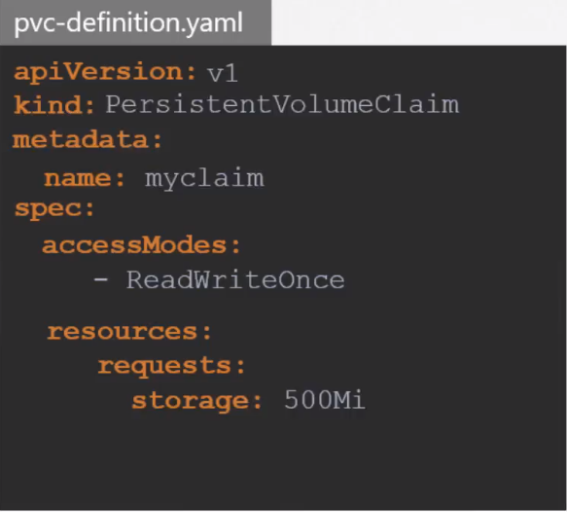
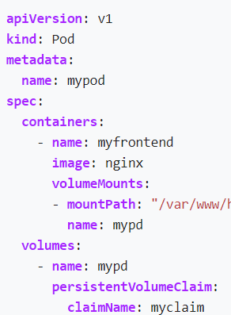

PVC
Pv -claim
PVC- bind with pod
Bound pv with matchlabels
Kubectl get pod --show-label
Kubectl delete pvc <name>
Kubectl get pvc
Kubectl describe pvc
Reference URL: https://kubernetes.io/docs/concepts/storage/persistent-volumes/#claims-as-volumes

Slide 11
Configmaps
A ConfigMap is an API object used to store non-confidential data in key-value pairs. Pods can consume ConfigMaps as environment variables, command-line arguments, or as configuration files in a volume.
A ConfigMap allows you to decouple environment-specific configuration from your container images, so that your applications are easily portable.
Reference Link:https://kubernetes.io/docs/concepts/configuration/configmap/

Slide 12
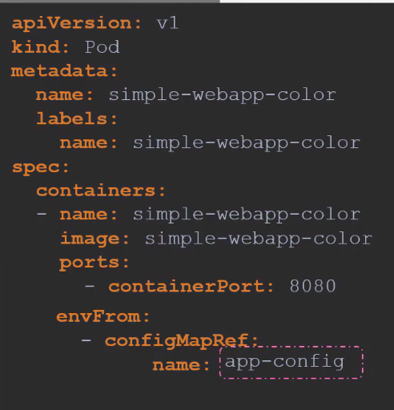
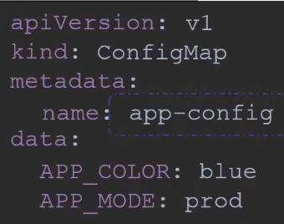

Slide 13
Secrets
A Secret is an object that contains a small amount of sensitive data such as a password, a token, or a key. Such information might otherwise be put in a Pod specification or in an image. Users can create secrets and the system also creates some secrets.
Encrypt the secrets : echo -n 'admin' | base64
Secrets are stored in encoded or encrypted format for safe and security purpose.
Secrets accept both imperative and declarative way of creation.

Slide 14
Secrets – imperative way
Way-1
Syntax: kubectl create secret generic <secret_name> --from-literal=<key>=<value>
Ex:
# Kubectl create secret generic app-secret --from-literal=username=john \
--from-literal=password=passwd
Way-2
Syntax: kubectl create secret generic app-secret --from-file=<path_to_file>
Ex:
# kubectl create secret generic app-secret --from-file=app_sec.properites

Slide 15
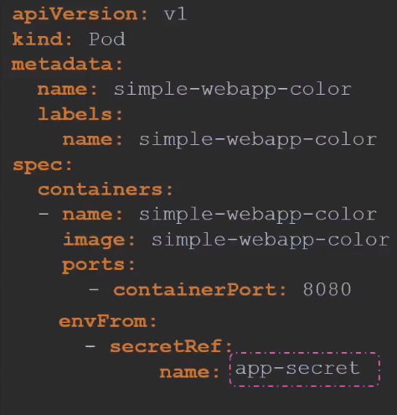
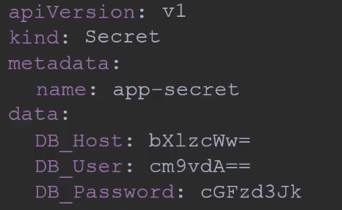
Secrets – declarative way
Pod with secrets
Secret with encoded data’s

